Slide 1
Prior austenite reconstruction: a graph sectioning problem
Tuomo Nyyssönen
Tampere University

Slide 2
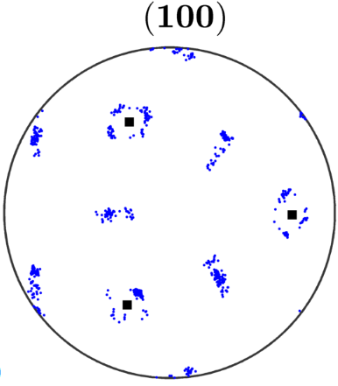
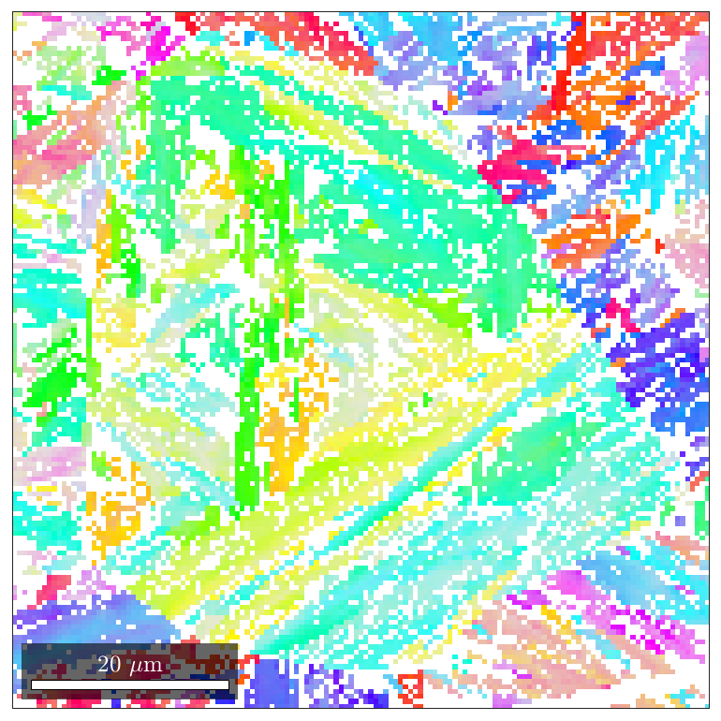
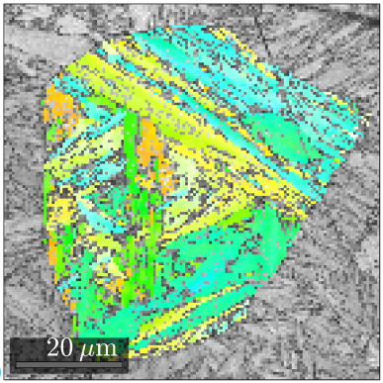
Orientation map of martensite

Slide 3
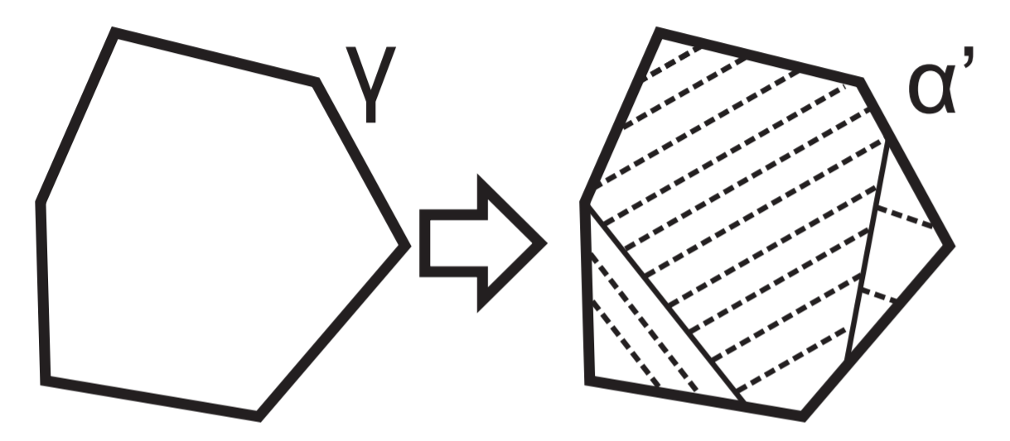
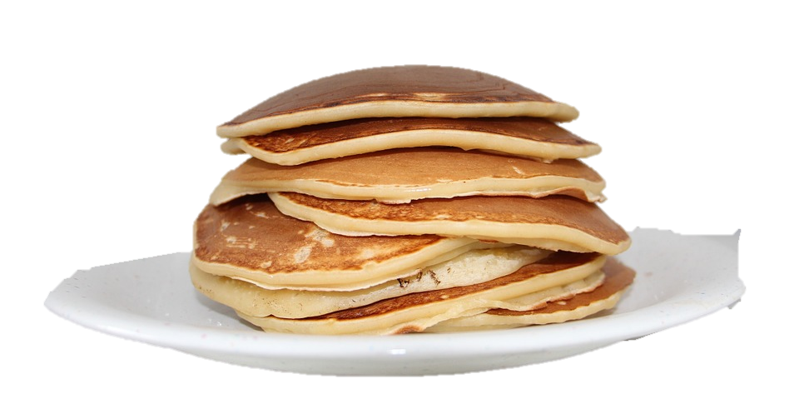
Martensite is not really composed of grains like ferrite and austenite
Instead martensite is composed of laths formed through a shear transformation from grains
Stacked ellipsoids – like a pile of pancakes!

Slide 4
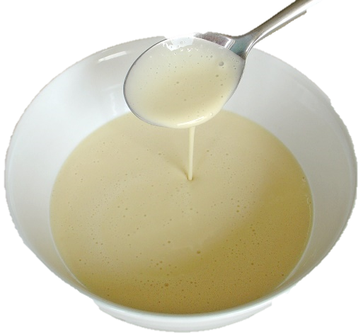
THE PROBLEM BEHIND THE PROBLEM
Pancakes are made from flour mix. But when you make the pancakes, you can’t study the flour mix any more!
The ”flour mix” here is austenite at ~700 – 1000 °C so it’s a bit tricky to study anyway!

Slide 5
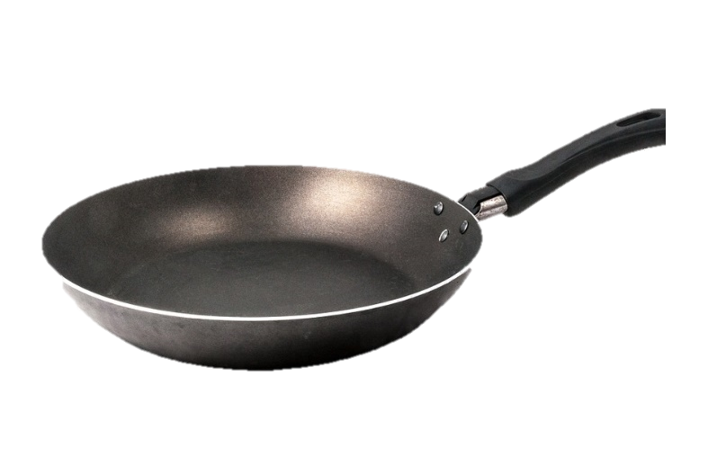
Mathematically, the relationship looks like this:
Relationship of pancake (martensitic lath) to flour mix (parent austenite):
24 pancakes (Pi) viewed from 24 directions (Ci)

Slide 6
We are interested in the relationships of the pancakes to each other, however....
Stacked ellipsoids – like a pile of pancakes!

Slide 7
Mathematically, we therefore need something like this:
Two pancakes (martensitic laths) i and j originating from the same mix (parent austenite). How to describe their relationship:
Only the pan (orientation relationship) is required to describe the relationships between pancakes (martensitic laths)!

Slide 8
Happily...
The list describing all possible relationships between pancakes (martensitic laths) has only 24 candidates!

Slide 9
Graph problems
Modelling of relations and processes in physical, biological, social and informations systems.

Slide 10
A graph is a collection of: - nodes - edges
A
B

Slide 11
Graph problems: medicine

Slide 12
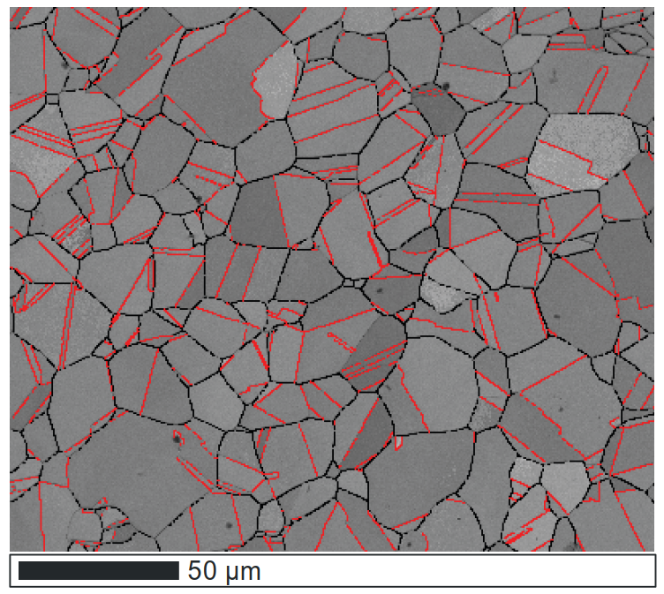
Graphs in steel

Slide 13
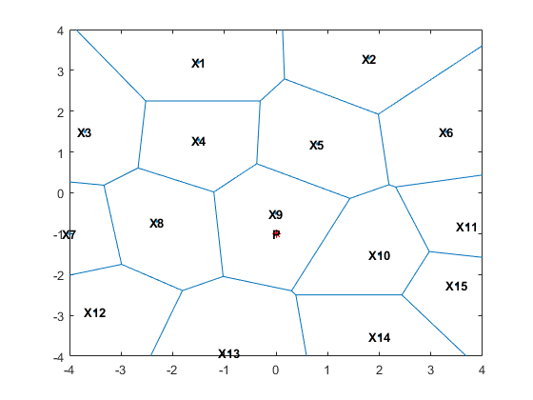
Graphs in steel

Slide 14
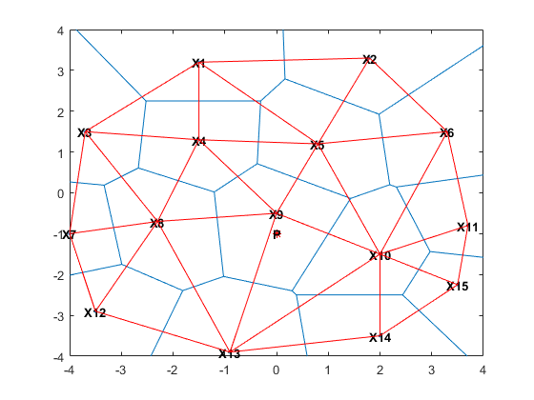
Graphs in steel

Slide 15
A graph is a collection of: - nodes - edges
A
B

Slide 16
Graphs in steel

Slide 17
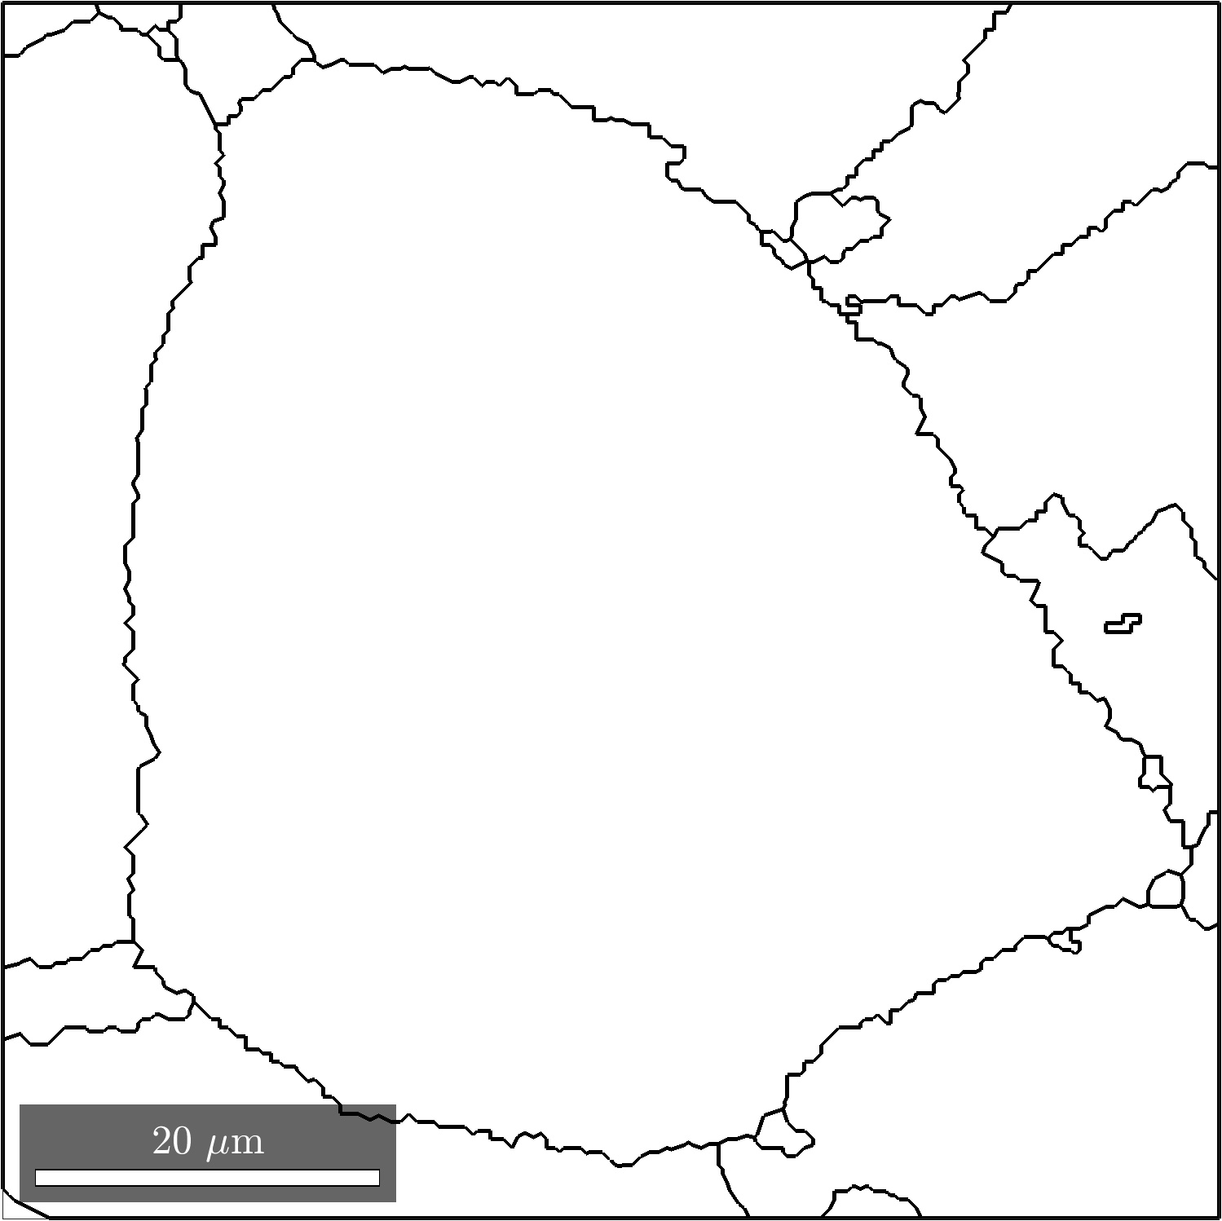
Austenite

Slide 18
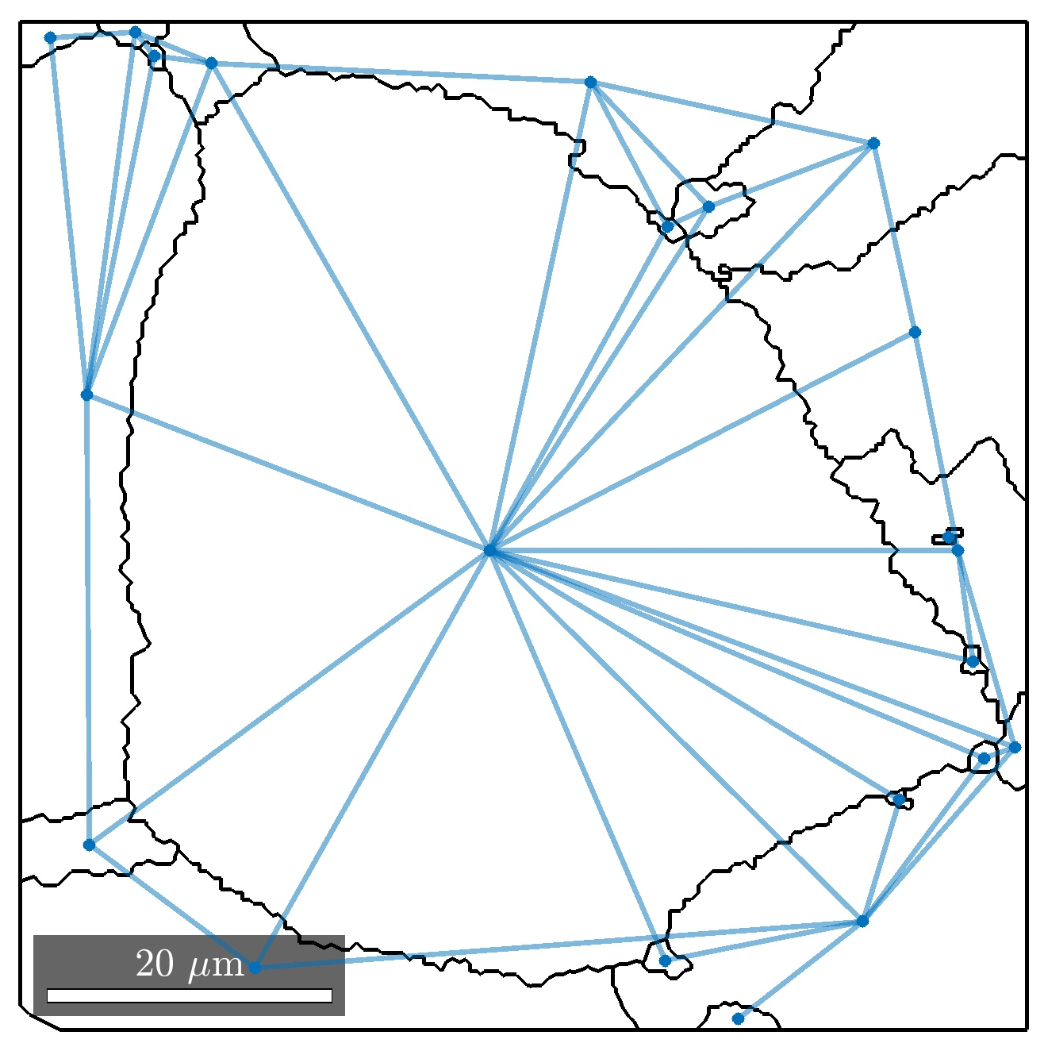
Austenite as a graph

Slide 19
Austenite as a graph

Slide 20
Austenite

Slide 21
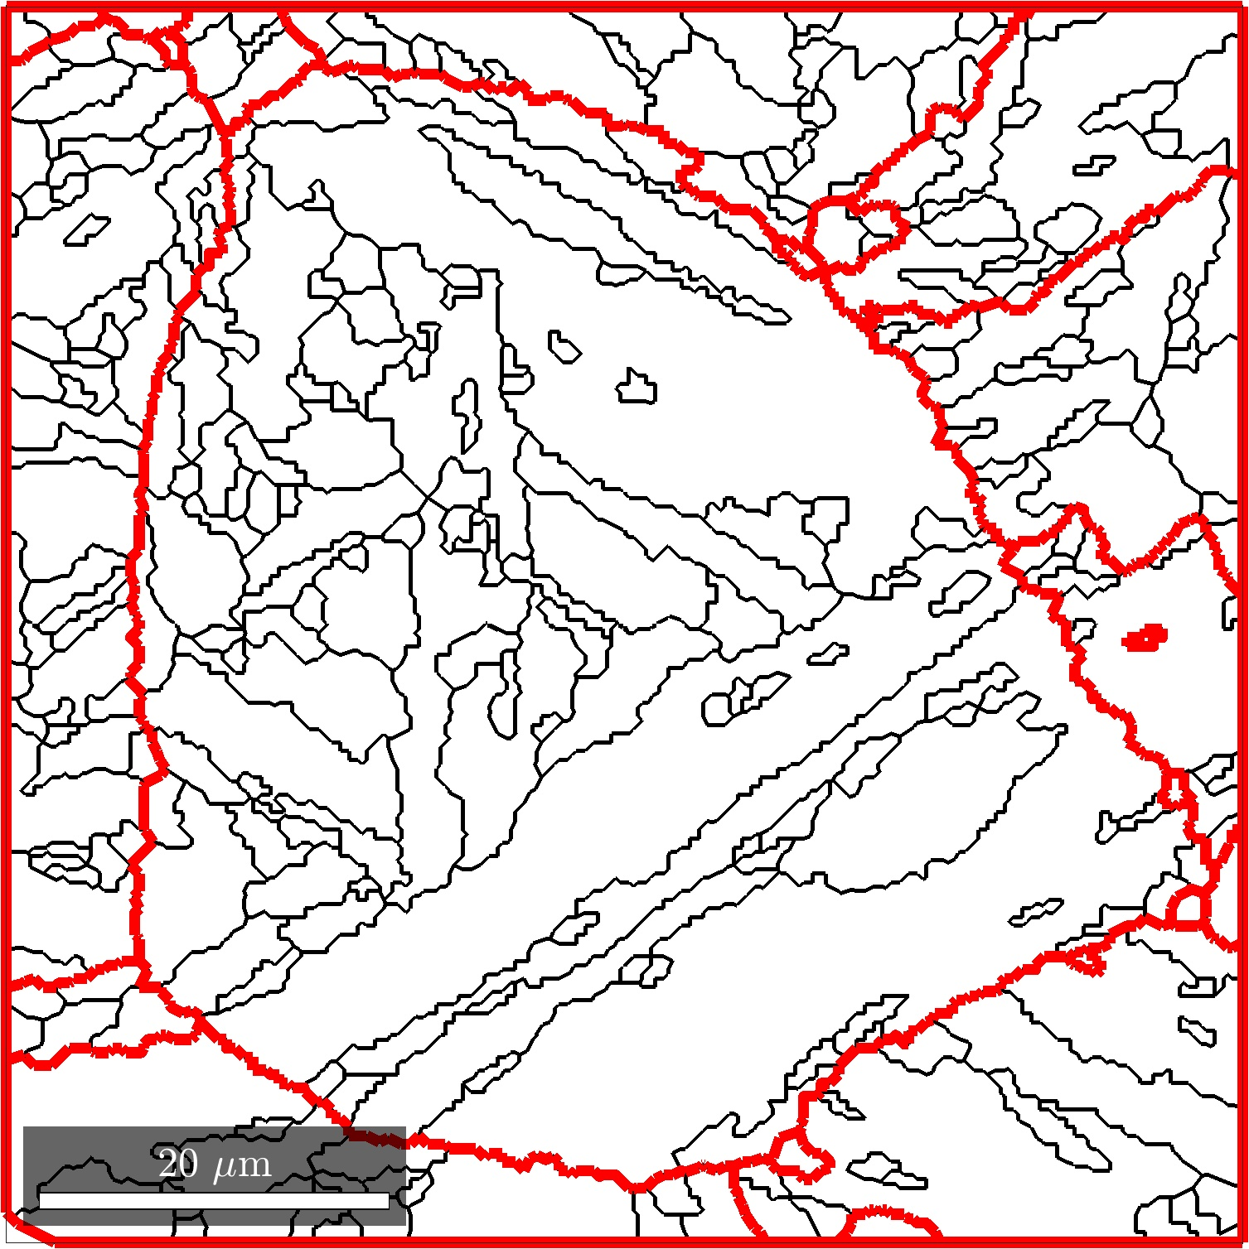
Martensite

Slide 22
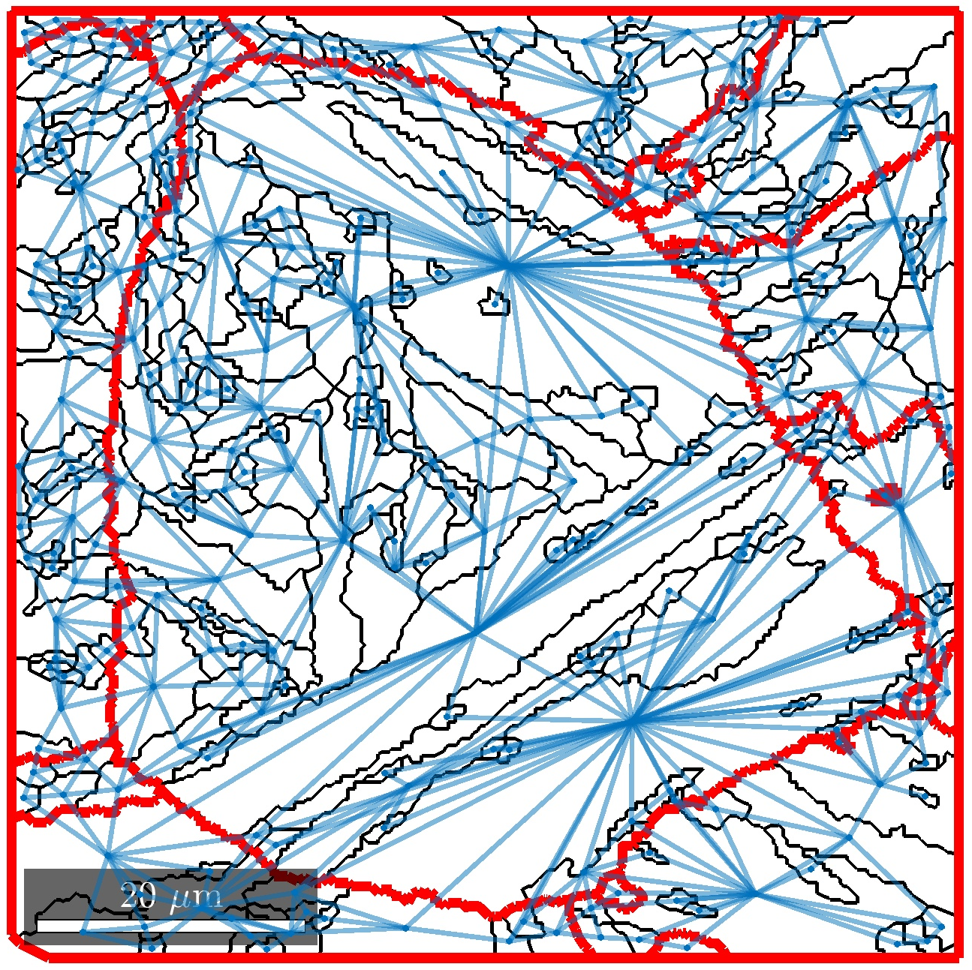
Martensite as a graph

Slide 23
Martensite as a graph

Slide 24
Happily...
The list describing all possible relationships between pancakes (martensitic laths) has only 24 candidates!

Slide 25
Misorientation-based analysis may help:

Slide 27
Iterative procedure gives you a decent result!

Slide 28
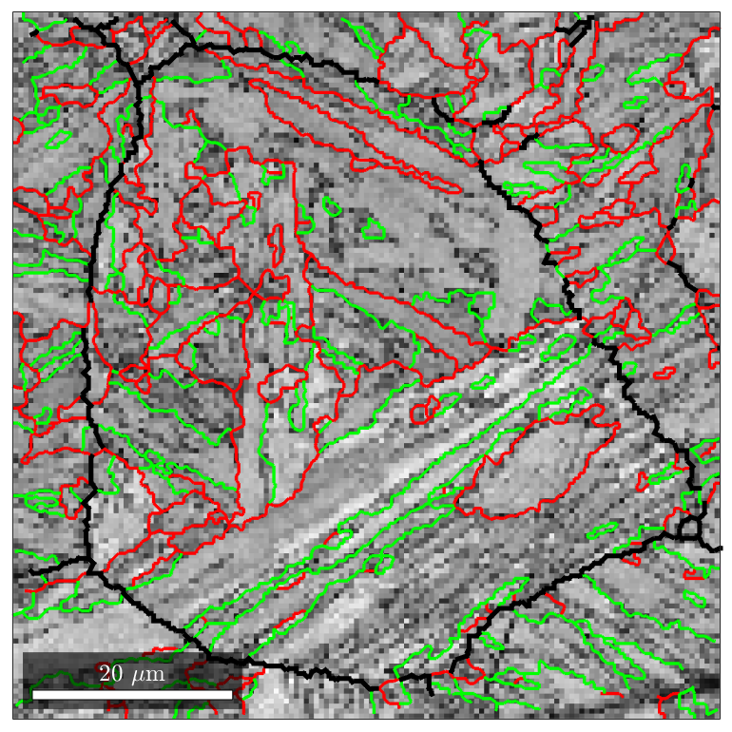
We can now do the following:
We have an orientation map measured via EBSD from a martensitic surface. We will now divide the boundaries between laths (pancakes) to block and packet boundaries using the definition:

Slide 29
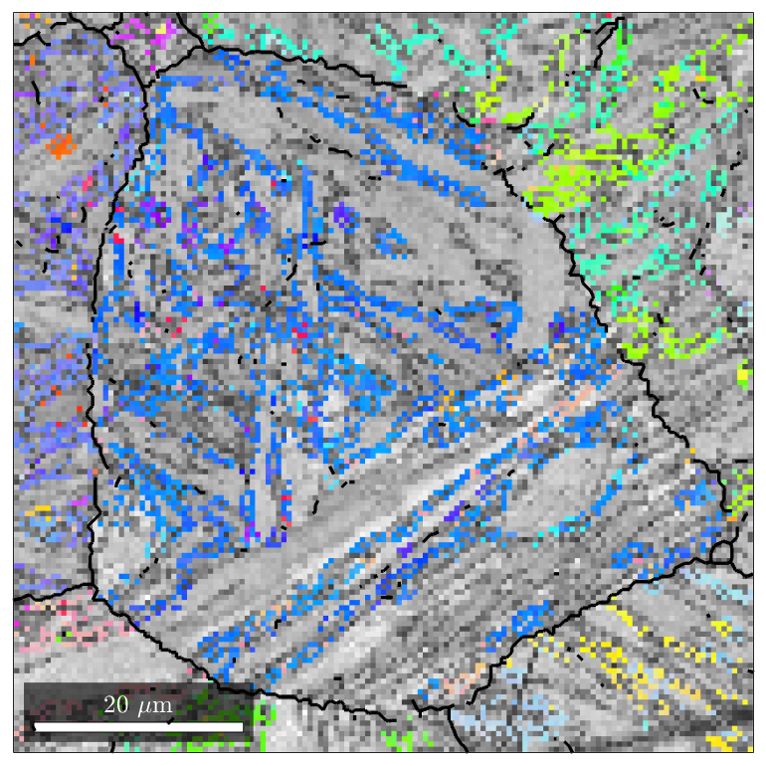
While doing so...
We have essentially defined parent orientations for all the analyzed misorientations!

Slide 30
What does MCL do?

Slide 31
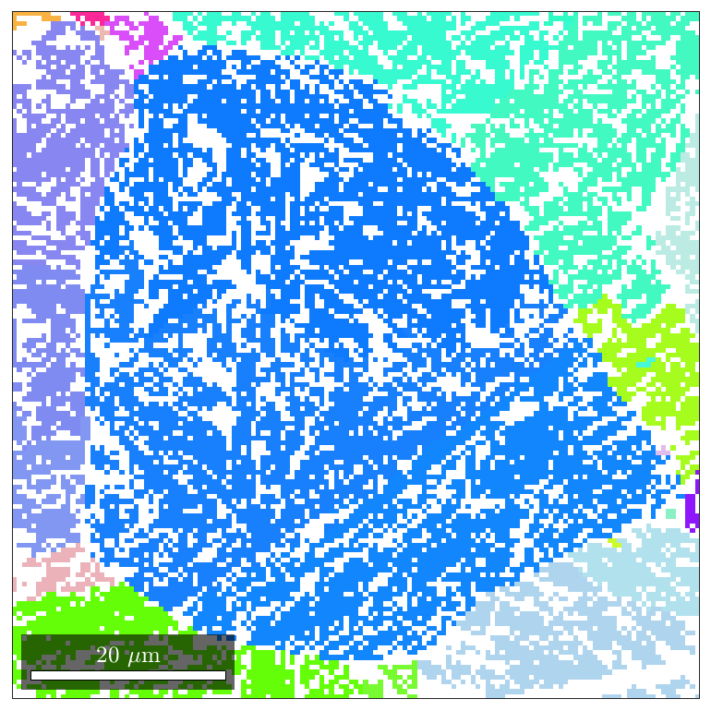
What we get!

Slide 32
Quite often the problem is twinning.

Slide 34
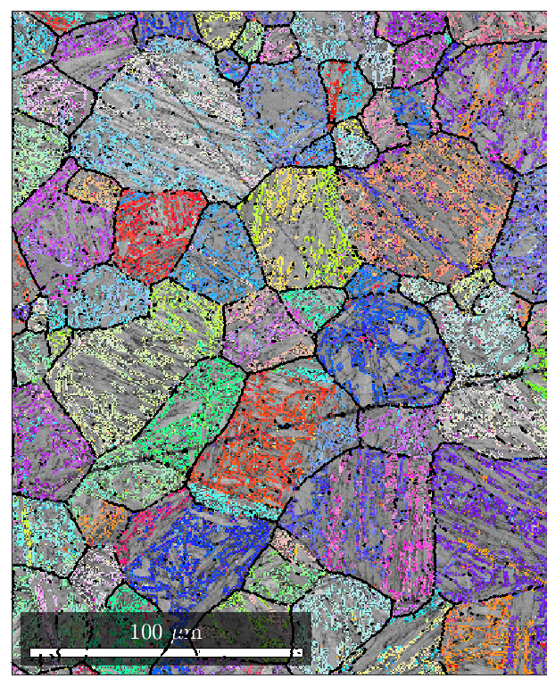
A reference map becomes available for comparison with whatever algorithm.

Slide 35
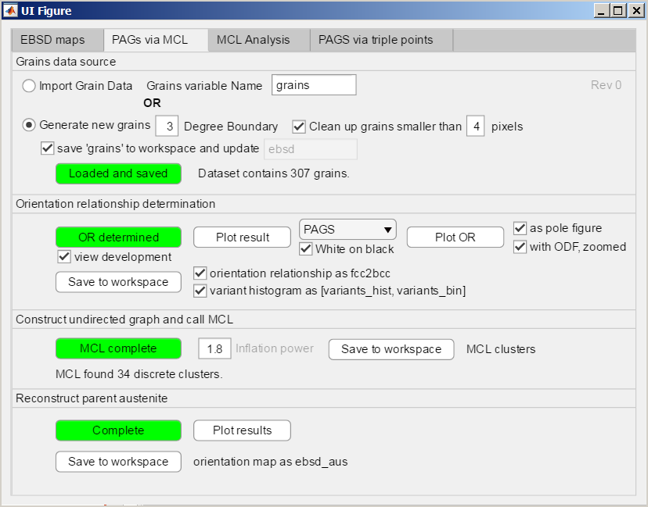
Software for analysis

Slide 36
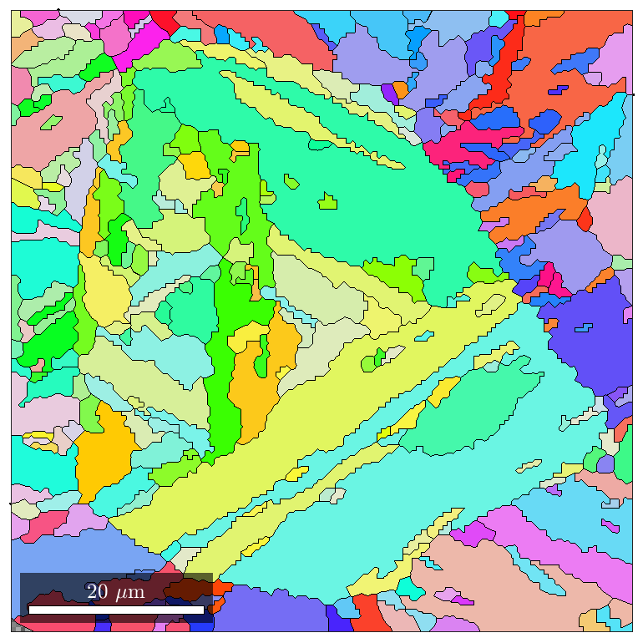
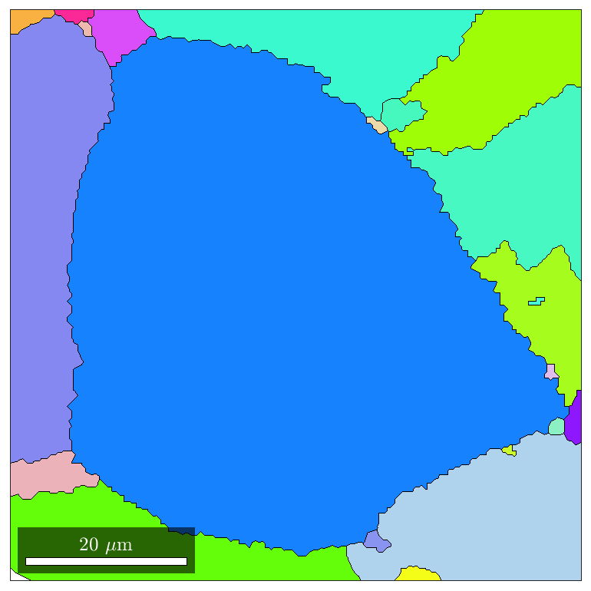
Software for analysis

Slide 37
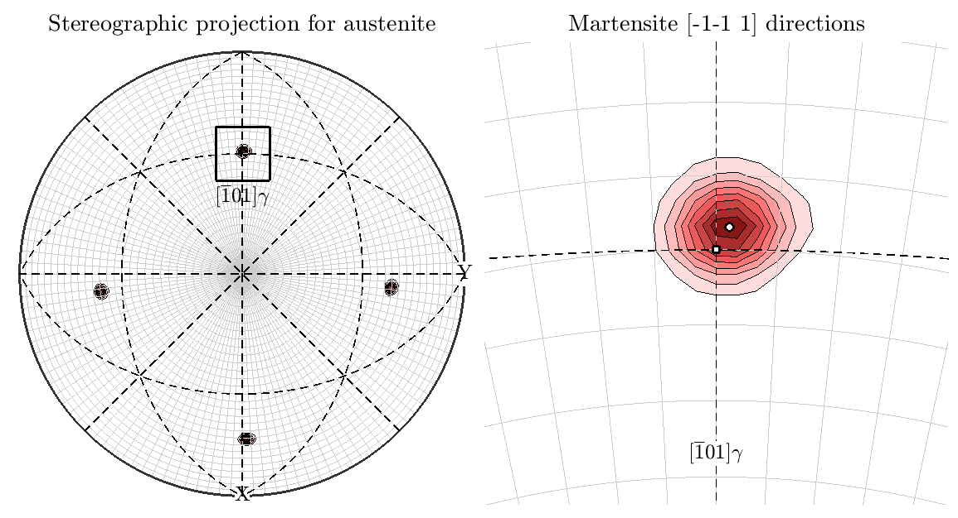
Software for analysis

Slide 38
More details

Slide 39
Software for analysis
Researchgate
Parent austenite reconstruction for Matlab with MTEX: graphical user interface
Tuomo Nyyssönen
e-mail
tuomoknyyssonen@gmail.com
Github
https://github.com/nyyssont/parent_austenite_reconstruction

Slide 40
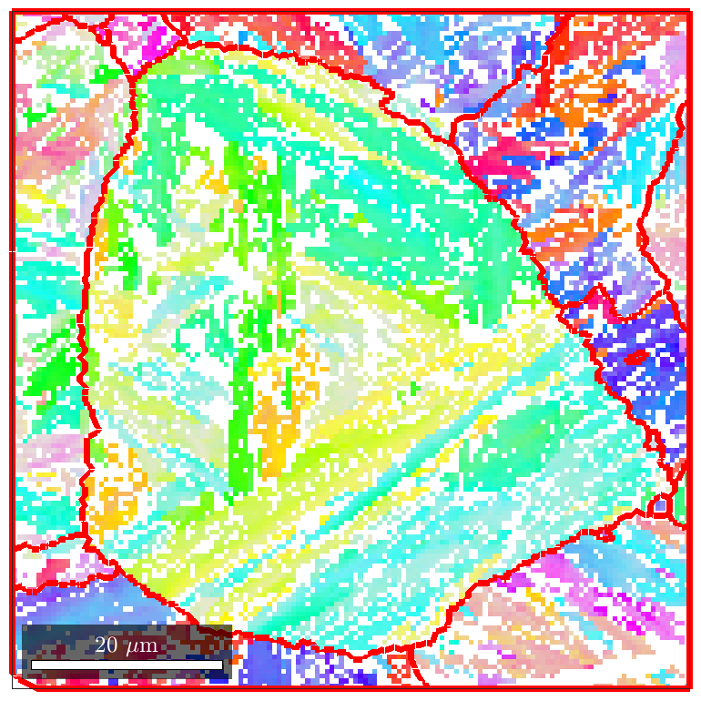
Two basic reconstruction methods:

